Slide 1

Tech Workers & Mental Health
Summer Training | CGC University Mohali
Presented by
Course
Date
B.Tech Blockchain — 2024-2028
1 July 2026
Samarth Bhatt | 2405043188

Slide 2
Agenda
01
Problem Statement & Objective
02
Dataset Overview
03
Data Model & Structure
08
04
Dashboard Walkthrough
09
05
Key Insights & Findings
1
2 / 12

Slide 3
01 Problem Statement
What problem does this dashboard solve?
3 / 12

Slide 4
Problem Statement & Objectives
The Problem
Target User
HR teams in tech companies struggle to understand mental health
treatment patterns from raw survey data, making it hard to target wellness programs effectively.
HR departments, tech company leadership, and mental health organizations who need a clear view of treatment-seeking patterns across employee groups.
Project Objectives
Clean and analyze the survey dataset using Python (Pandas, NumPy)
Design an interactive multi-page dashboard with 5+ visual types
Build Excel summary tables and conditional formatting dashboards
Publish the final report to Power BI Service
Create meaningful DAX measures for treatment rate, age, and respondent counts
4 / 12

Slide 5
02 Dataset Overview
Source, structure, and key fields
5 / 12

Slide 6
Dataset Overview
Kaggle (OSMI)
CSV
1,253
25
Source
File Type
Rows
Columns
Key Columns Used
Data Quality Steps (Power Query)
Column | Role in Dashboard
Age, Gender | Core demographics; slicers and gender chart
treatment | Target variable for treatment-seeking analysis
family_history | Strongest predictor of treatment-seeking
remote_work | Used in Remote Work vs Treatment pie chart
Country | Used in the map visual and country analysis
Removed invalid Age values (-1726, 99 billion)
Standardized 40+ Gender entries into 3 categories
Filled missing self_employed and work_interfere values
Dropped Timestamp and free-text comments columns
Filtered Age to a realistic 18–75 range
Exported the cleaned dataset to Excel for Power BI
6 / 12

Slide 7
03 Data Model
Flat table structure & key DAX measures
7 / 12

Slide 8
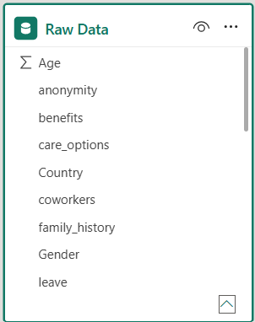
Data Model
Data Model Overview
Schema Type: Single Flat Table
Table Name: Raw Data
Number of Tables: 1
Relationships: None
Purpose: Stores all survey data in a single table for analysis and visualization.
Used For:
Creating Dashboard Visuals
Building DAX Measures
Applying Filters & Slicers
Interactive Data Analysis
8 / 12

Slide 9
04 Dashboard Walkthrough
Pages, visuals, and interactivity
9 / 12

Slide 10
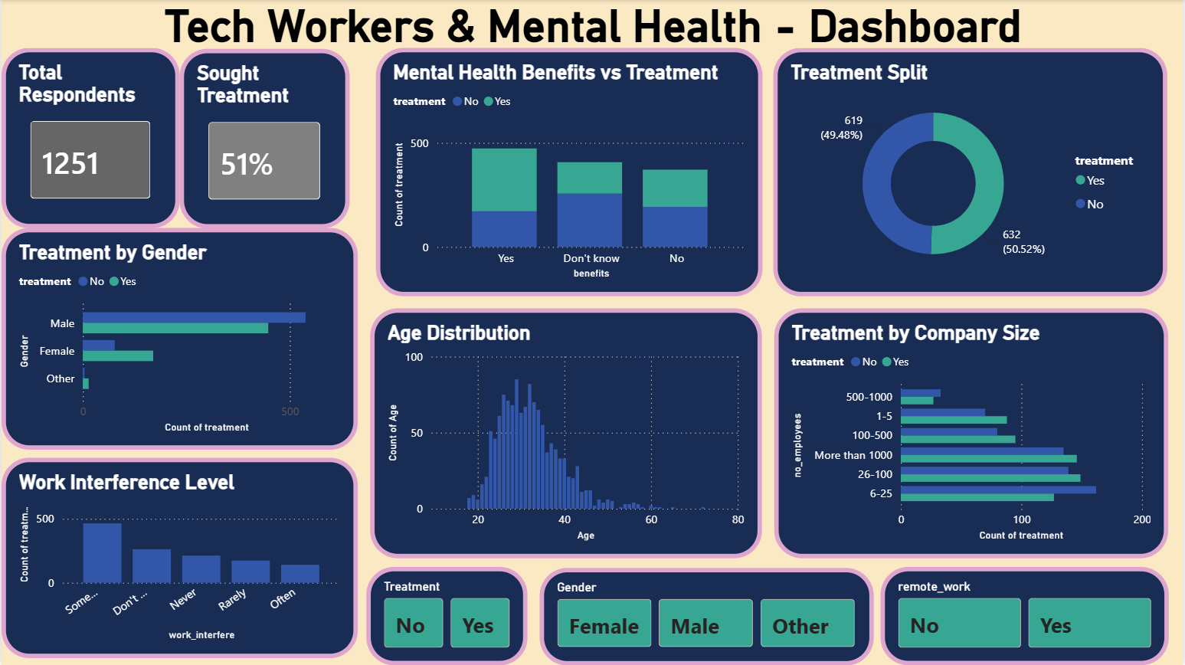
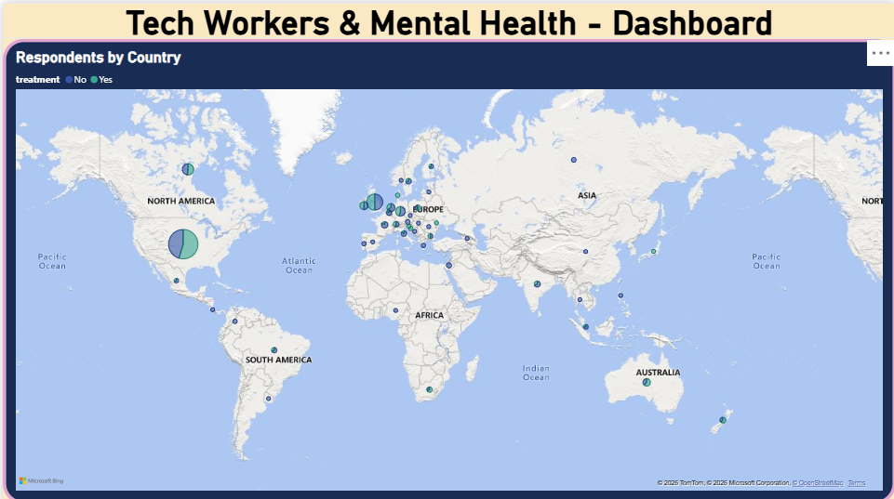
Dashboard — Page 1: Overview
Visuals on this page
KPI Cards — Total Respondents, Treatment Rate %
Donut Chart — Treatment Split
Bar Chart — Treatment by Gender
(See Page 2 for Map — Respondents by Country)
Slicers — Gender / treatment / remote_work
Key Insight
Treatment-seeking is nearly an even split (~51% Yes), but females seek treatment at a noticeably higher rate than males.
10 / 12

Slide 11
Key Findings & Insights
Treatment-seeking is nearly evenly split — 51% Yes vs 49% No across 1,253 respondents.
Females seek treatment at a notably higher rate than males, reflecting greater openness to seeking help.
01
04
Employees with a family history of mental illness seek treatment at a significantly higher rate.
48% of respondents say mental health affects their work "Sometimes" or "Often."
02
05
Remote workers show a higher treatment-seeking rate than office-based employees.
03
11/ 12

Slide 12
Conclusion & Thank You
Successfully built an end-to-end Power BI solution from raw data to published dashboard
Key finding: family history and remote-work status are the strongest predictors of treatment-seeking
Proud of standardizing 40+ inconsistent Gender entries into clean categories using Python
Future scope: track mental health trends over time with repeated survey waves
Thank You!
Questions & Discussion
12/ 12

